Slide 1



MediMind
SolVIT
Team Number - 57 Room Number - 019
HOSTEL_COMMITTEE
MARCH 2025

Slide 2
MediMind
Quantum Crew
YASH GOYAL - 24BAI10100
VISHWESH SINGH - 24BAI10404
RAJ SACHAN - 24BCE10022
TRISHA KAPOOR - 24BAI10659
ARYAN KUMAR RAI - 24BAI10151
JIYA JAISWAL - 24BAI10275
HOSTEL_COMMITTEE
MARCH 2025

Slide 3
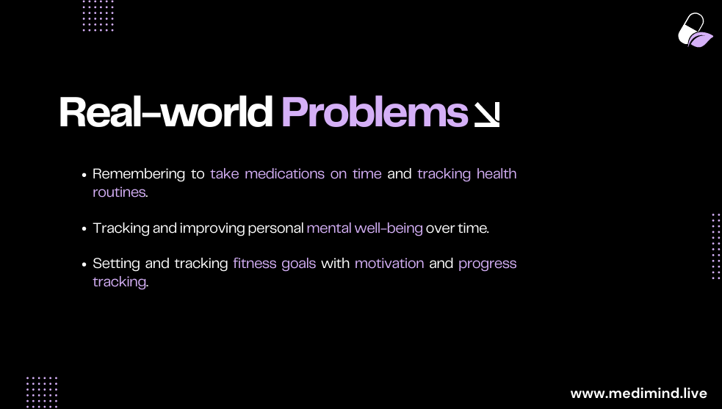

Slide 4
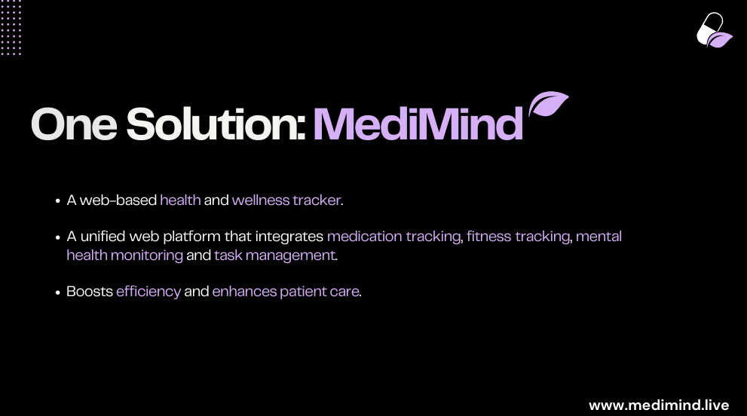

Slide 5
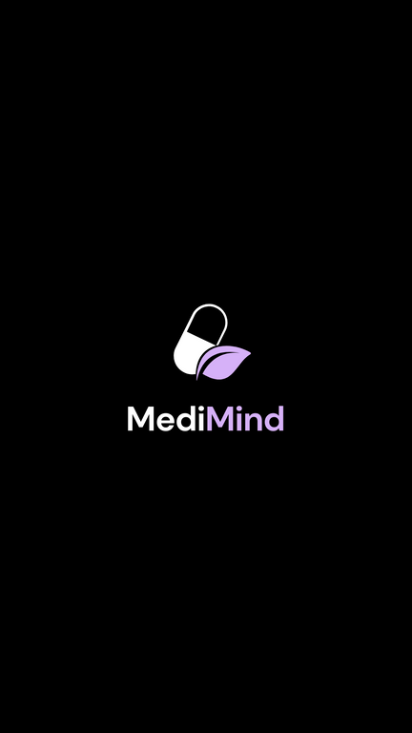
Key Features
Medication Tracker: Set reminders for medications, track adherence, and receive alerts for missed doses.
Fitness Tracker: Log workouts, set fitness goals, and monitor progress with visual charts.
Medipedia : Displays information about the medicine what the user is taking .
To-Do List Compilation: Manage daily tasks and integrate them with health routines for a balanced lifestyle.
www.medimind.live

Slide 6




TECH STACK
Frontend: HTML, CSS, React.js , JavaScript
Backend: Node.js, Firebase , PHP , Google Cloud (Database)
Notifications: Flask (Python) , JSON , FCM
Sources Used:
Online tutorials for frontend design and responsive layouts.
Backend frameworks and APIs for data handling and reminders.
Tutorial for editing JSON files
www.medimind.live

Slide 7

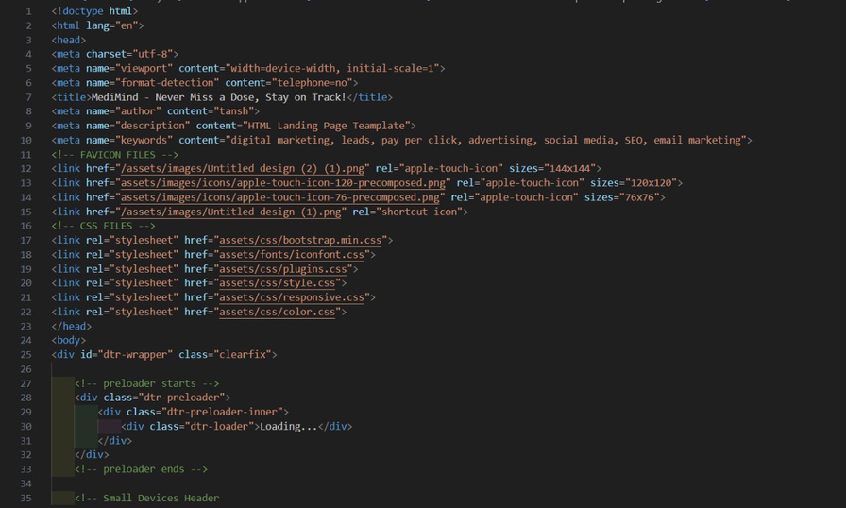
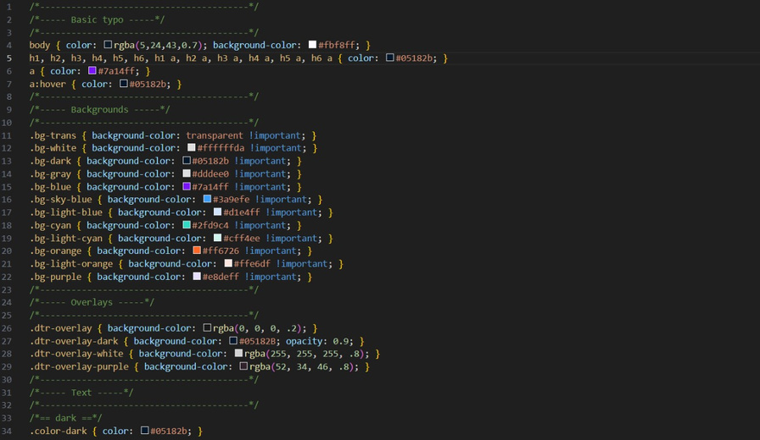
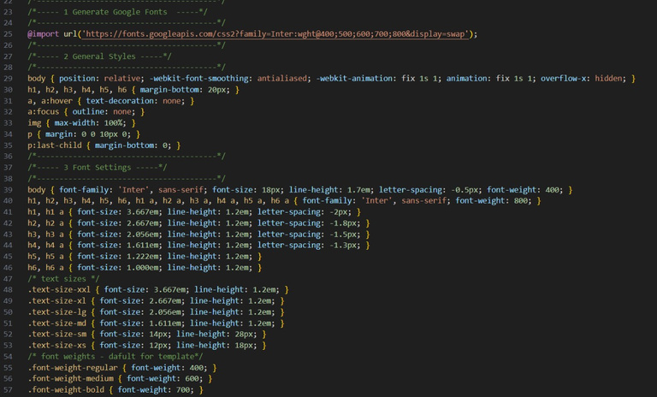
CODE SNIPPETS
www.medimind.live

Slide 8
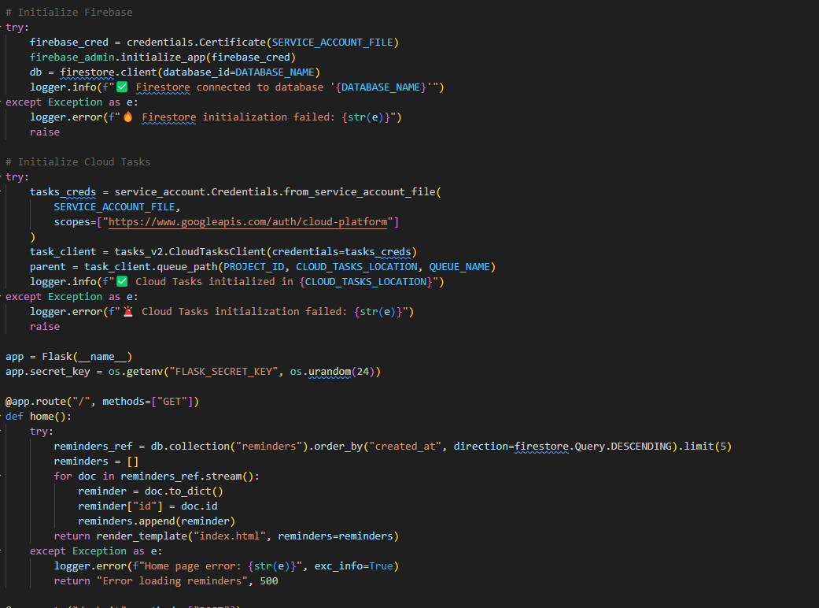
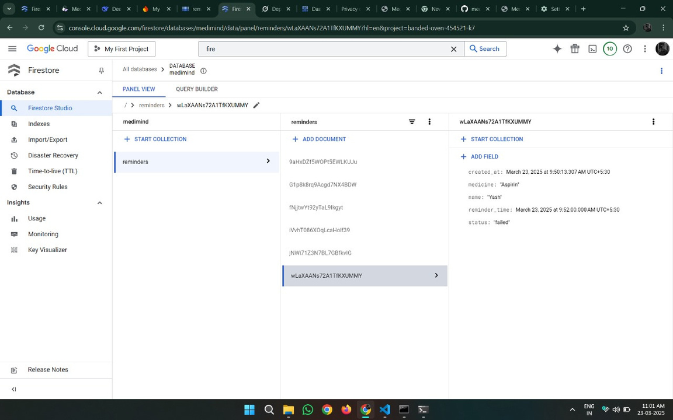
BACKEND
DATABASE
FLASK (PYTHON)
www.medimind.live

Slide 9
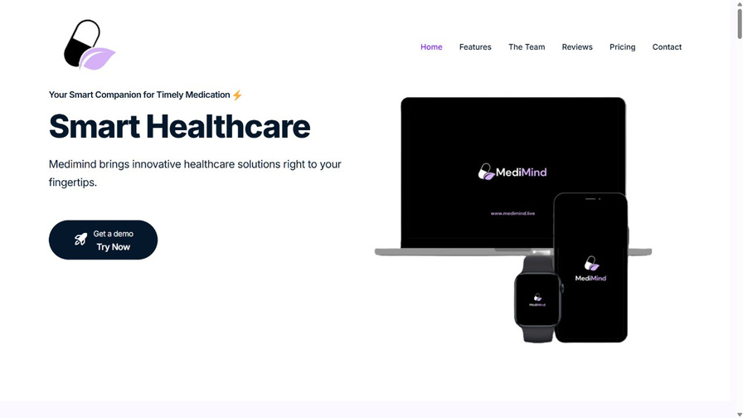
UI/UX
DATABASE SCHEME
www.medimind.live

Slide 10
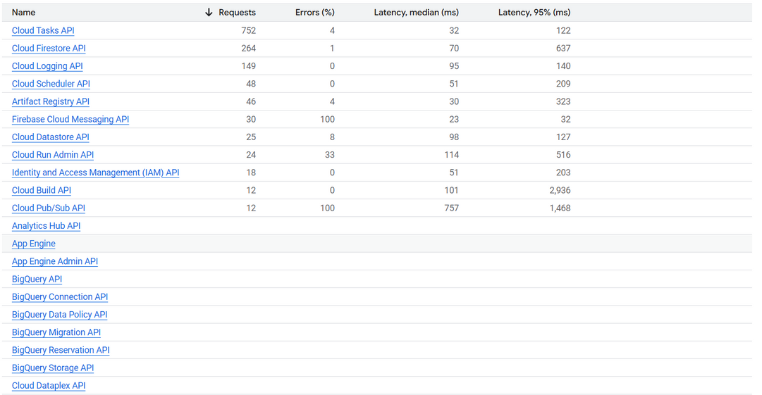
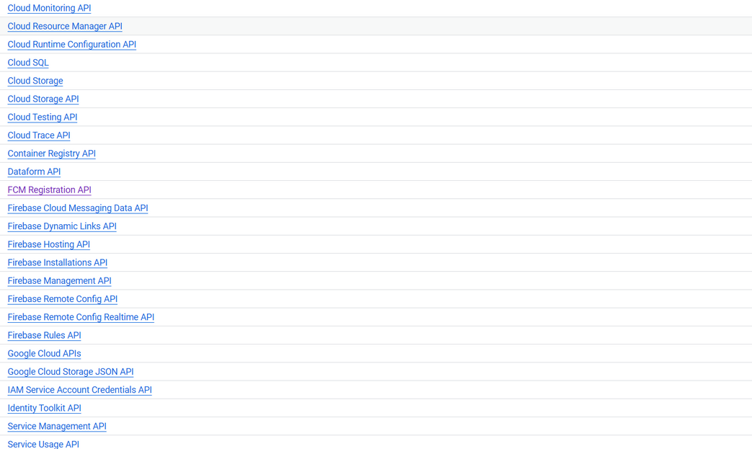
API INTEGRATION
www.medimind.live

Slide 11
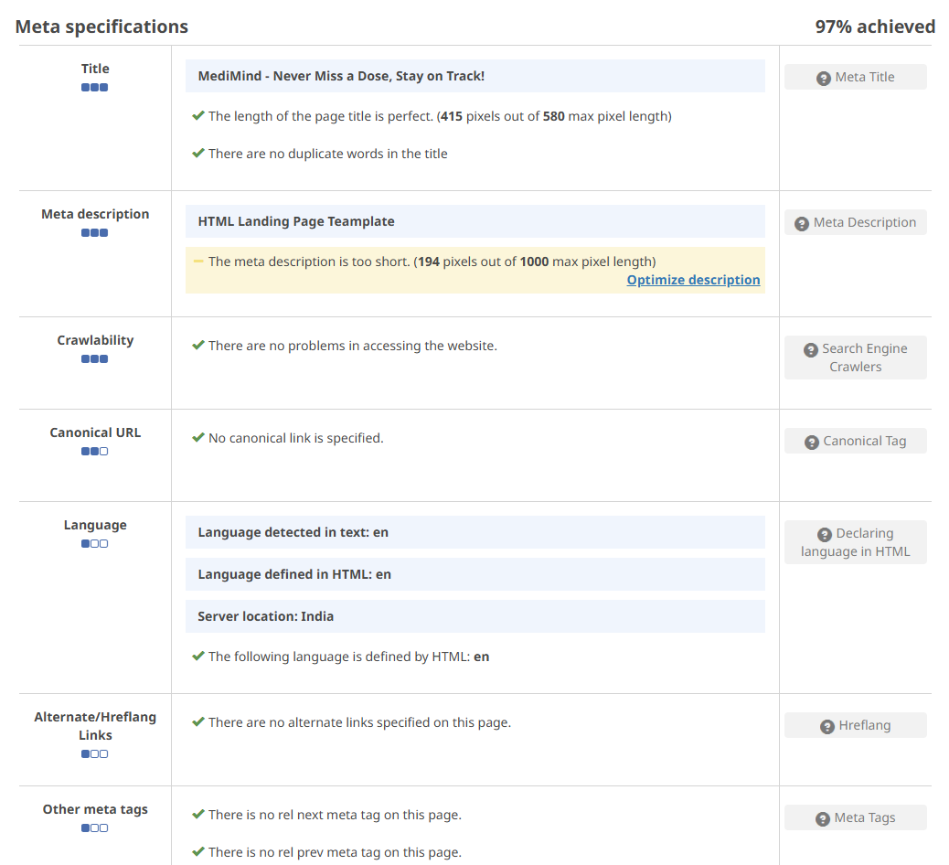
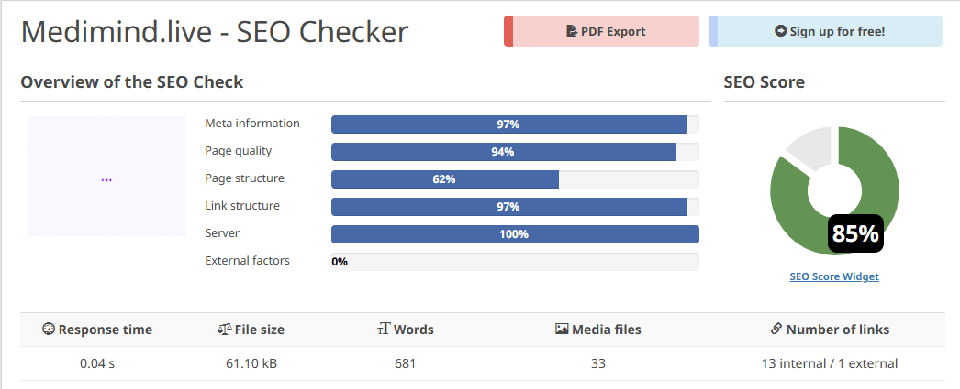
SEO – SEARCH ENGINE OPTIMISATION
www.medimind.live

Slide 12
FUTURE ADDITIONS
VOICE COMMAND INTEGRATION :
Hands-free control for adding tasks, setting reminders, and checking health stats.
Approach: Use a simple voice recognition tool like Web Speech API to capture commands and link them to existing features.
MENTAL HEALTH TRACKER :
Mood journaling, guided meditations, and stress analysis.
Approach: Add a mood logging section with emoji-based mood tracking, paired with a library of pre-recorded meditations and relaxation tips.
www.medimind.live

Slide 13
SYMPTOM CHECKER :
AI-based symptom analysis providing insights and recommending actions.
Approach: Implement a basic questionnaire that compares symptoms to a preloaded database, offering recommendations based on common conditions.
COMMUNITY SUPPORT FEATURE :
A forum or chat system for users to share experiences and advice.
Approach: Integrate a simple discussion board where users can create threads and reply to each other, with basic moderation tools.
ADVANCED ANALYTICS DASHBOARD :
Visual reports on fitness, medication adherence, and overall progress.
Approach: Display charts using a simple library like Chart.js, summarizing weekly and monthly trends.
WEARABLE DEVICE INTEGRATION :
Sync data from smartwatches and fitness bands for real-time updates.
Approach: Connect with popular fitness devices using their native apps or APIs (like Google Fit or Apple Health).
www.medimind.live

Slide 14
Conclusion
MediMind aims to provide a holistic approach to health and wellness by integrating essential tracking features into a single, user-friendly web platform. This integrated solution can significantly improve users' ability to manage their health and daily tasks efficiently, accessible from any device with a web browser.
www.medimind.live

Slide 15
MediMind
THANK YOU

